Slide 1
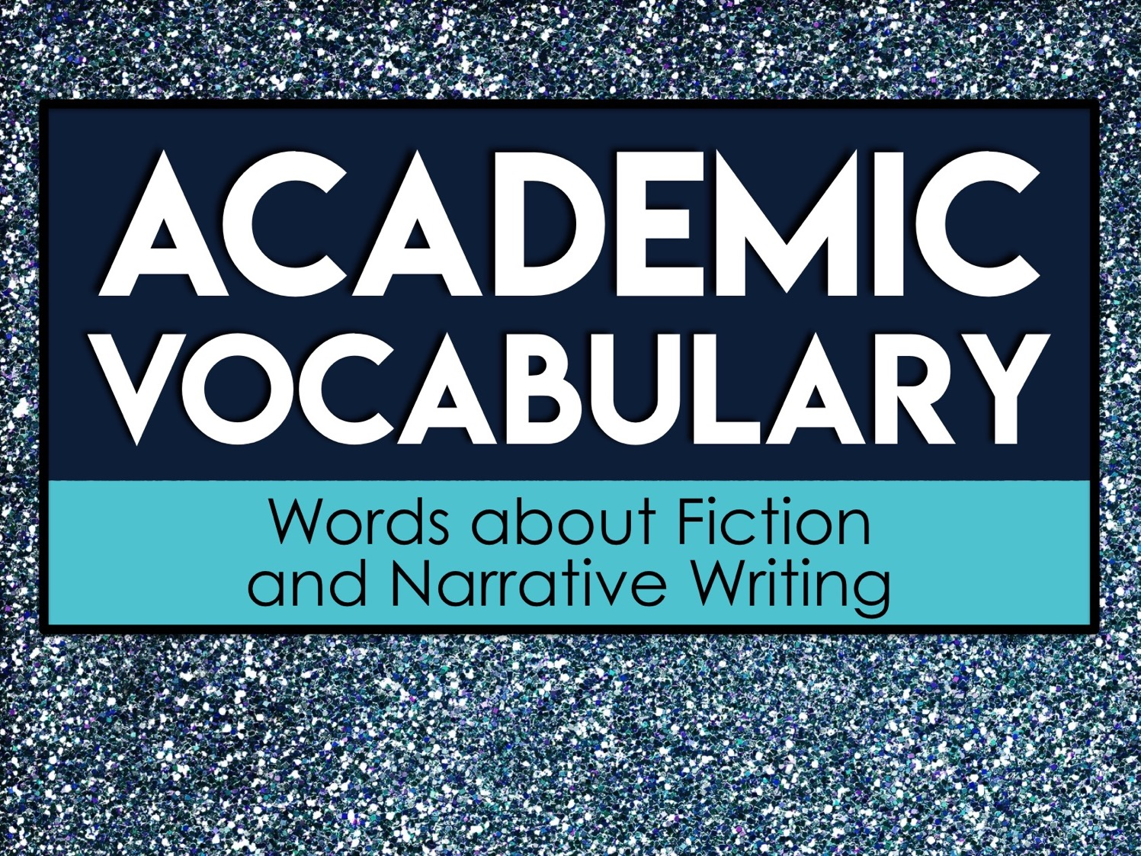
Academic
Vocabulary
Words about Fiction
and Narrative Writing

Slide 2
About Academic Vocabulary
Academic vocabulary refers to words that you will likely encounter in an academic setting.
Academic vocabulary shows up in text books, standardized tests, and in instructions for school assignments.
The more academic vocabulary you know, the more likely you are to be successful in school!

Slide 3
Focus on Five at a Time
We will learn 25 new academic vocabulary terms during this unit.
However, we will only focus on five words at a time.
Each week we will have five new words to learn.

Slide 4
Our Week in Academic Vocabulary
Monday: Introduce the words.
Tuesday: Draw it out.
Wednesday: Word Web Wednesday!
Thursday: Reflect about the words.
Friday: Quiz time!
End of the unit: We will review ALL 25 of the academic words you’ve learned.

Slide 5
Monday
On Mondays, we will take a quick pretest on five new vocabulary words.
Then, we will go over each word.
You’ll write the words and their definitions on your weekly handout.

Slide 6
Tuesday
On Tuesdays, we will take a few minutes to review the words.
During this time, you’ll draw a quick visual representation for each word.
The drawings do not need to be perfect. Anything that helps you associate the word to the definition will help you!

Slide 7
Wednesday
On Wednesdays, we will take a few minutes to review the words.
During this time, you’ll create a word web for each word.
A word web is a graphic representation containing words. You’ll write words that have similar meanings and words that are associated with the vocabulary term on your paper.

Slide 8
Word Web Example
language
list
vocabulary
terms
words

Slide 9
Thursday
On Thursdays, we will take a few minutes to review the words.
During this time, you’ll look over all of the work from the week and write a brief reflection about what you learned.
Your reflection should be at least three sentences long and contain some of the vocabulary words.

Slide 10
Reflect/Journal
Your vocabulary journal/reflection should be at least three sentences long. You can use these questions to help get you started.
What did you learn about the words?
What word did you not know prior to this week?
How do these words relate to one another?
How will knowing these words help you succeed in an academic setting?

Slide 11
Friday
On Fridays, we will take a quick test on five vocabulary words from the week.
After the test, you’ll record your score and write down the words you still need to study.
As we continue with new words, make sure you go back and revisit the words you still need to learn.

Slide 12
Academic
Vocabulary
Words about Fiction
and Narrative Writing

Slide 13
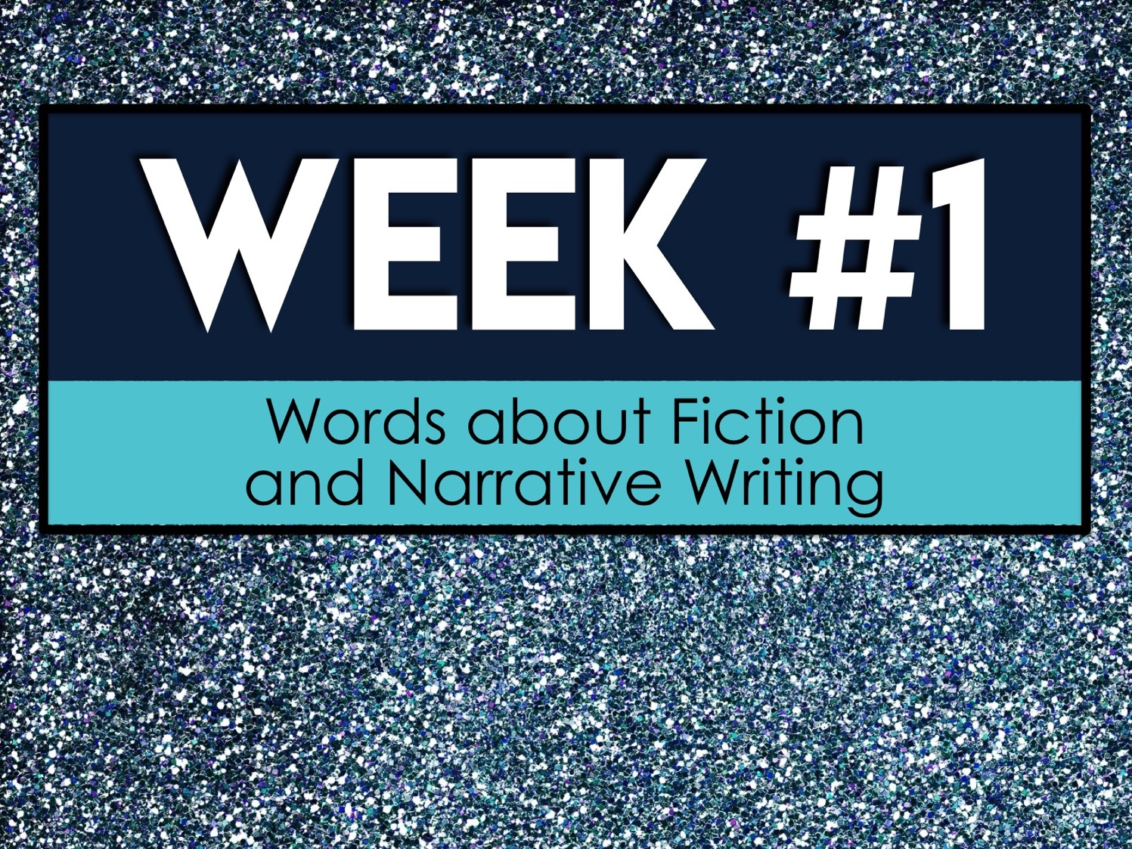
Week #1
Words about Fiction
and Narrative Writing

Slide 14
Week #1 Words
Allusion
Antagonist
Climax
Conflict
Connotation

Slide 15
Week #1 Pretest
DIRECTIONS: In your own words, try your best to define each term.
Allusion
Antagonist
Climax
Conflict
Connotation

Slide 16
Allusion
an author’s purposeful reference to something else in a literary work

Slide 17
Antagonist
a person who actively opposes or is hostile to someone or something; an adversary

Slide 18
Climax
the point in a narrative at which the conflict or tension hits the highest point

Slide 19
Conflict
a literary element that involves a struggle between two opposing forces usually a protagonist and an antagonist

Slide 20
Connotation
a quotation from or reference to a book, paper, or author, especially in a scholarly work

Slide 21
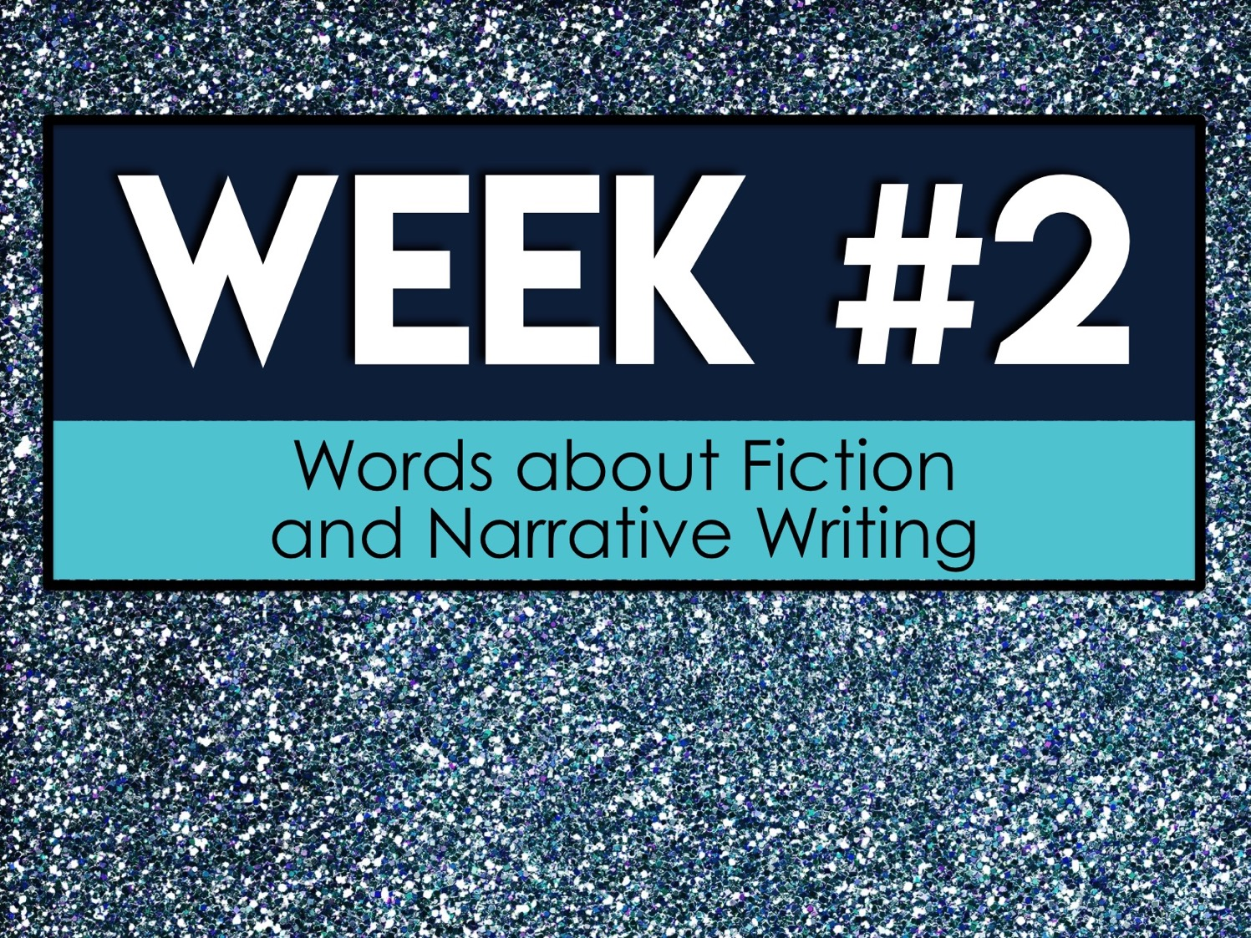
Week #2
Words about Fiction
and Narrative Writing

Slide 22
Week #2 Words
Denotation
Dynamic character
Exposition
Falling action
Fiction

Slide 23
Week #2 Pretest
DIRECTIONS: In your own words, try your best to define each term.
Denotation
Dynamic character
Exposition
Falling action
Fiction

Slide 24
Denotation
direct and specific meaning

Slide 25
Dynamic character
a character that changes throughout the course of the narrative

Slide 26
Exposition
a literary device used to introduce background information about events, settings, characters etc. to the audience or readers

Slide 27
Falling action
the part of a literary plot that occurs after the climax has been reached and the conflict has been resolved

Slide 28
Fiction
literature in the form of prose, especially short stories and novels, that describes imaginary events and people

Slide 29

Week #3
Words about Fiction
and Narrative Writing

Slide 30
Week #3 Words
Flashback
Flat character
Foreshadowing
Inciting incident
Mood

Slide 31
Week #3 Pretest
DIRECTIONS: In your own words, try your best to define each term.
Flashback
Flat character
Foreshadowing
Inciting incident
Mood

Slide 32
Flashback
moments identified by the author that relate to previous events

Slide 33
Flat character
characters that are two-dimensional and are relatively uncomplicated

Slide 34
Foreshadowing
clues by the author that allude to later events

Slide 35
Inciting incident
the event that sets the central conflict in motion

Slide 36
Mood
feeling(s) evoked in the reader as a reaction to the narrative’s atmosphere

Slide 37
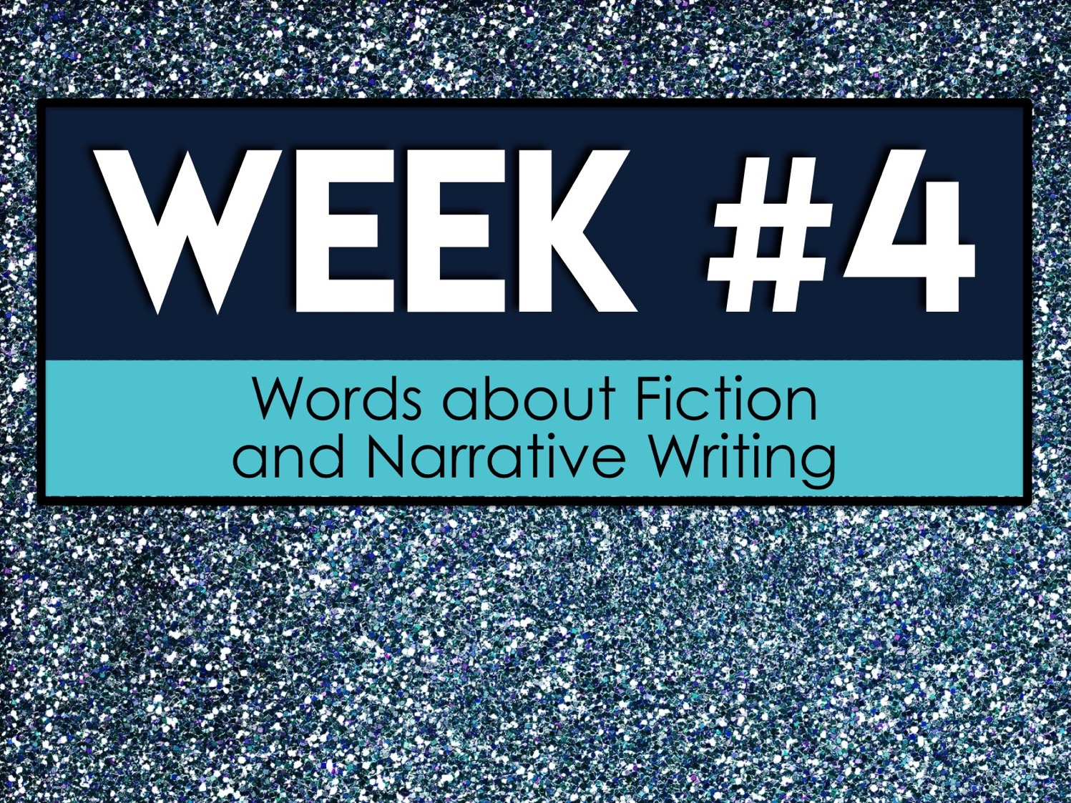
Week #4
Words about Fiction
and Narrative Writing

Slide 38
Week #4 Words
Narrative
Plot
Point-of-view
Protagonist
Resolution

Slide 39
Week #4 Pretest
DIRECTIONS: In your own words, try your best to define each term.
Narrative
Plot
Point-of-view
Protagonist
Resolution

Slide 40
Narrative
a spoken or written account of connected events; a story

Slide 41
Plot
the events that make up a storyline

Slide 42
Point-of-view
the narrator's position in relation to the story being told

Slide 43
Protagonist
the leading character or one of the major characters in a drama, movie, novel, or other fictional text

Slide 44
Resolution
the point in a literary work at which the chief dramatic complication is worked out

Slide 45
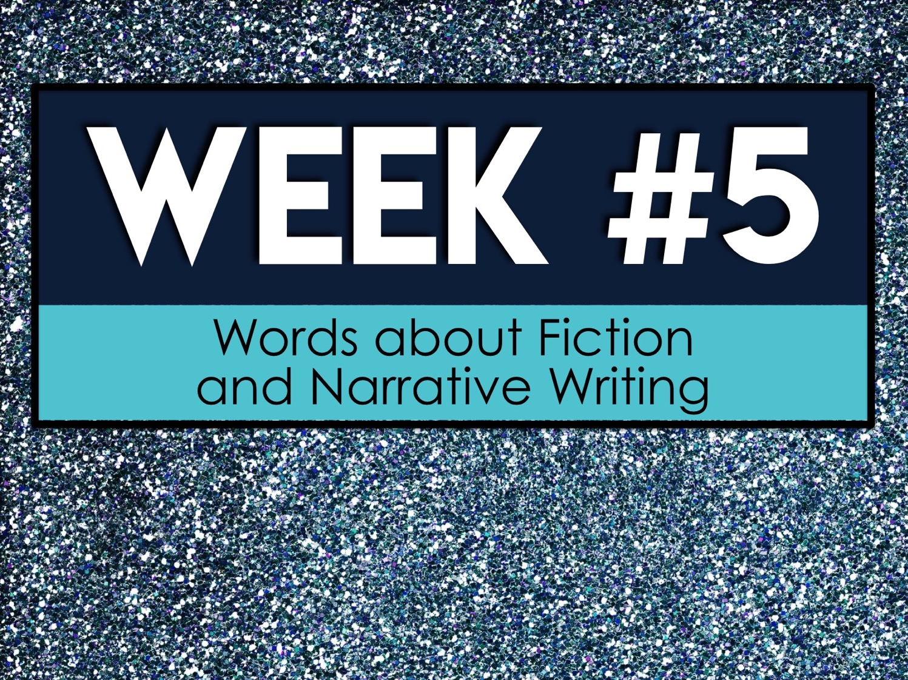
Week #5
Words about Fiction
and Narrative Writing

Slide 46
Week #5 Words
Rising action
Round character
Static character
Theme
Tone

Slide 47
Week #5 Pretest
DIRECTIONS: In your own words, try your best to define each term.
Rising action
Round character
Static character
Theme
Tone

Slide 48
Rising action
a related series of incidents in a literary plot that build toward the point of greatest interest

Slide 49
Round character
a realistic character that displays multiple character traits that is complex

Slide 50
Static character
a character that does not change throughout the course of the narrative

Slide 51
Theme
a main idea or an underlying meaning of a literary work that may be stated directly or indirectly

Slide 52
Tone
author’s attitude toward the subject/topic evoked through diction

